Slide 1
Translating Lost Languages with Machine Learning
by Derrick and Belle

Slide 2
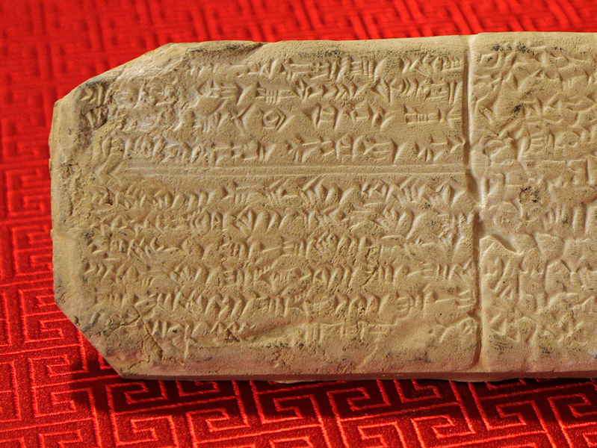
imaginetryingtodecipheraforeignlanguagewrittenlikethis
dead languages are undeciphered
don’t know enough about their grammar, vocabulary, or syntax to understand the language
Photo by MIT News

Slide 3
CUE MACHINE LEARNING.
relies on linguistic principles and constraints
embeds sounds into a multidimensional space
express lingual evolutions as computational constraints
model can segment words from the ancient language and map them to counterparts in another language

Slide 4
♔ − 👨 + 👩 = ♕
WORDS AS VECTORS.
KING − MAN + WOMAN = QUEEN

Slide 5
THE
PROCESS.
1.
2.
3.
4.
map relations for a specific language
machine scans the text to see how often each word appears next to every other word
each word has a specific pattern that defines the word in a “multidimensional parameter space”
vector acts as a constraint on how the word can appear in any translation the machine devises

Slide 6
LINGUAL CONSTRAINTS
Regularity of sound change
sounds mostly do not change significantly over time
preservation of sound
sounds mostly do not disappear over time
monotonicity of alignment
alignments of characters do not overlap
Notes:
languages can change in only certain ways
symbols in related languages appear with similar distributions within words
ex. a /b/ sound from a parent language may be substituted for a /p/ sound but is less likely to have a /k/ sound
Phonetic sounds of languages are pretty much the same now as they were back then,
monotonic(of a function) = function does not change from increasing to decreasing
characters of known tokens do not map to the same lost token

Slide 7
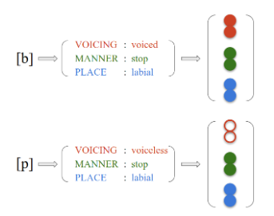
PHONETIC PROXIMITY
International Phonetic Alphabet (IPA)
each char represented as a vector of phonological features
Model uses IPA to map unknown chars to known chars
vectors of each phonological feature inserted into a space
chars with similar features are mapped together

Slide 8
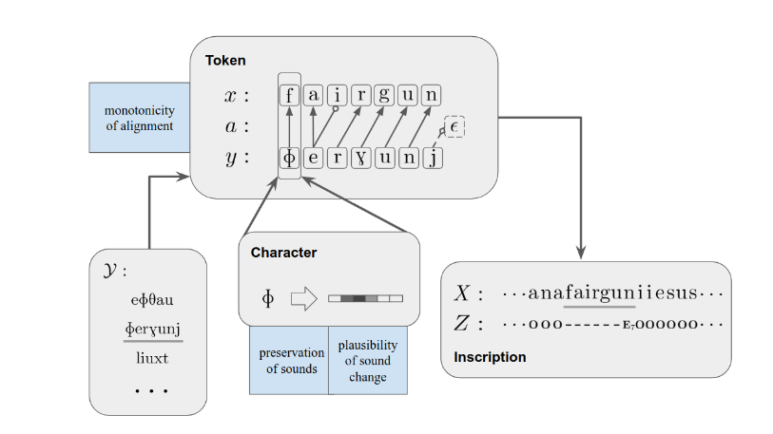
2.
3.
1.

Slide 9
FRAMEWORK
goal: for each lost text X, identify a list of non-overlapping spans {x} that map to
cognates in Y
list of chars (vocabulary) Y = {y} (known language)
applies lingual constraints and IPA character mapping to y and x
Generates inscription of lost language in stages
spans(chars) → tokens(words)
a = variable that denotes phonetic similarity between x and y
matching condition
tokens → inscription (overall text)
z = O: character in an unmatched span
z = E_{L}: end of entire matched span is marked
Notes:
Span = characters
Matched spans = spans of lost language that map to chars of known language
Unmatched spans = spans of lost language that do not map to chars of known language
tokens = words
cognates = words from different languages that share a same root word ex. family and familia

Slide 10
APPLICATIONS
Deciphering unknown languages
Learning about unknown phonetic sounds
phonetic value of lost characters can be mapped to known cognates
Better cognate detection
Notes:
Cognate: words from different languages that share a same root word ex. family and familia

Slide 11
THANK YOU!

Slide 12
CREDITS.
Presentation Template: SlidesMania
http://people.csail.mit.edu/j_luo/assets/publications/DecipherUnsegmented.pdf
https://news.mit.edu/2020/translating-lost-languages-using-machine-learning-1021
https://www.technologyreview.com/2019/07/01/65601/machine-learning-has-been-used-to-automatically-translate-long-lost-languages/

